Slide 1
Road Detection in Massive LIDAR Data
Presented by
Kunal Singha Roy
Poulomi Deb

Slide 2
Objective
  From a given LIDAR data set for a geographic region, extracting the road network present in that region

Slide 3
Goal
  The basic goal for our project is supervised machine learning.
  Initially we would be given a set of LIDAR data and the corresponding road network map for a particular region.
  We would try to identify certain points from the road network map and locate the same in the LIDAR data set.
  After locating these points in the LIDAR data set we would analyze the data and try to extract various attributes related to the points located.
  Once the analysis is done we would train the system with various attributes of the LIDAR data for both absence and presence of road.
  Finally, using this learning we would predict the road network for a different region from the LIDAR data set of that particular geographic region.

Slide 4
Requisites
Study about LIDAR.
Learn about LAS files, learn libLAS, compile and install libLAS.
Study about Shapefiles as the map data would be shapefiles.
Extract data from a LAS file and try to present it as an image file.
Learn and implement Supervised machine learning using SVM model.

Slide 5
Libraries and software used
  libLAS library which had various dependencies on other python libraries was used to process the LAS files.
  pyproj library was used for converting x, y coordinates to latitude and longitude and vice-versa under shapefile processing.
  numpy, PIL, math libraries were used for the general processing of the data.
  svm from the scikit-learn library was used for using the support vector machine model to train the system.
  KDTree was used from the scikit-learn library to calculate the nearby points of the LIDAR points during shapefile processing.

Slide 6
What we achieved
Task | Description
Processed LAS files and extracted data from them. | Managed to draw each data point from the LIDAR file (LAS file) with their corresponding RBG values and generated an image file which solved our purpose of visualization of the data provided.
Processed shapefiles. | Extracted parts of the shape file corresponding to a particular LIDAR tile. Successfully drew polylines on the LIDAR image to find out roads.
Created training data set. | Compared the shape file and LIDAR data points and tried to predict the roads with maximum accuracy. We labelled the points matching our prediction for the road as 1 and the points not matching as 0. Also we added the feature of getting the average height of the LIDAR data points by considering all the neighboring points.
Supervised machine learning. | Created an estimator module which uses SVM (Support Vector Machine) learning model for prediction. It first trains the system with the previously computed training data. It then takes a LAS file as input for prediction of the road network.

Slide 7
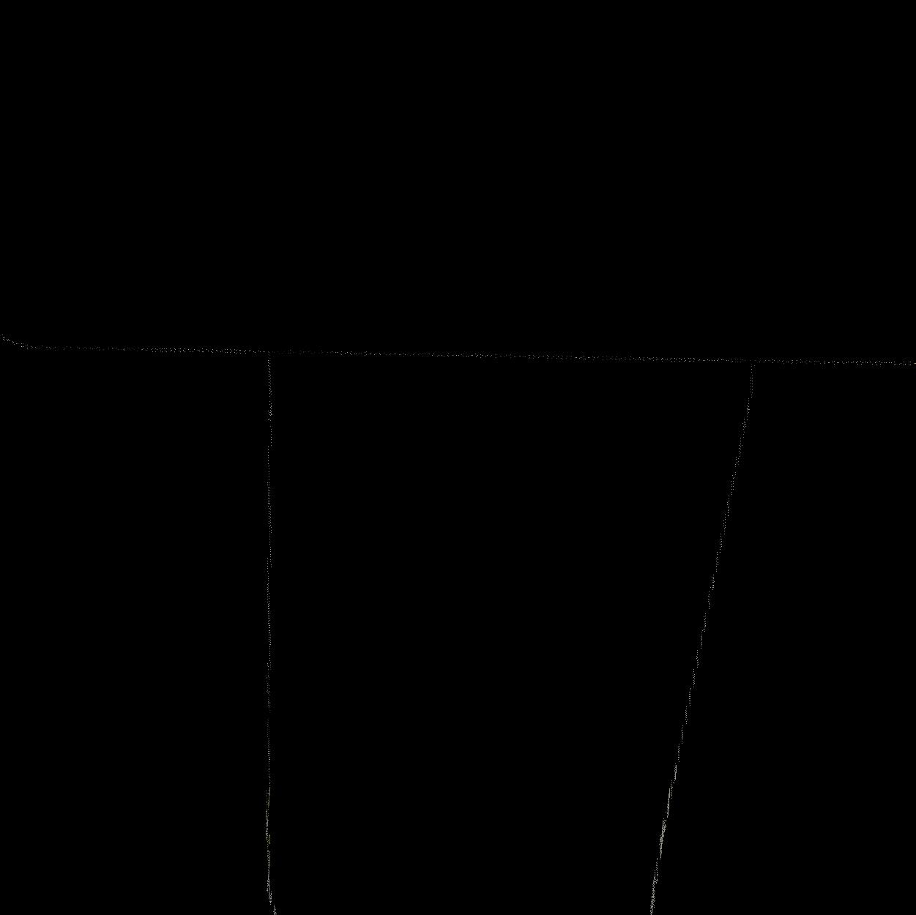
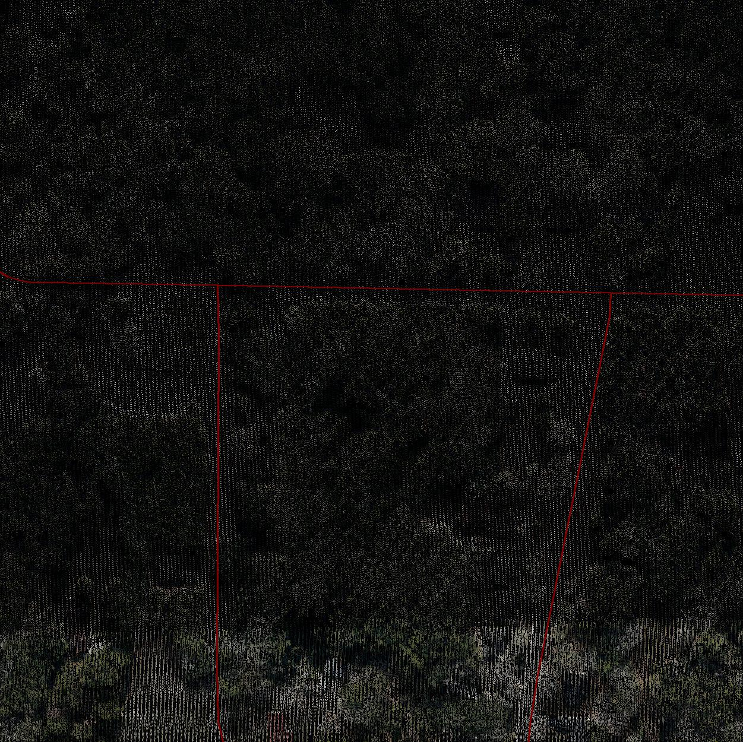
Prediction of road network
LIDAR data points corresponding to a road extracted from a shapefile
Road drawn on LIDAR image

Slide 8
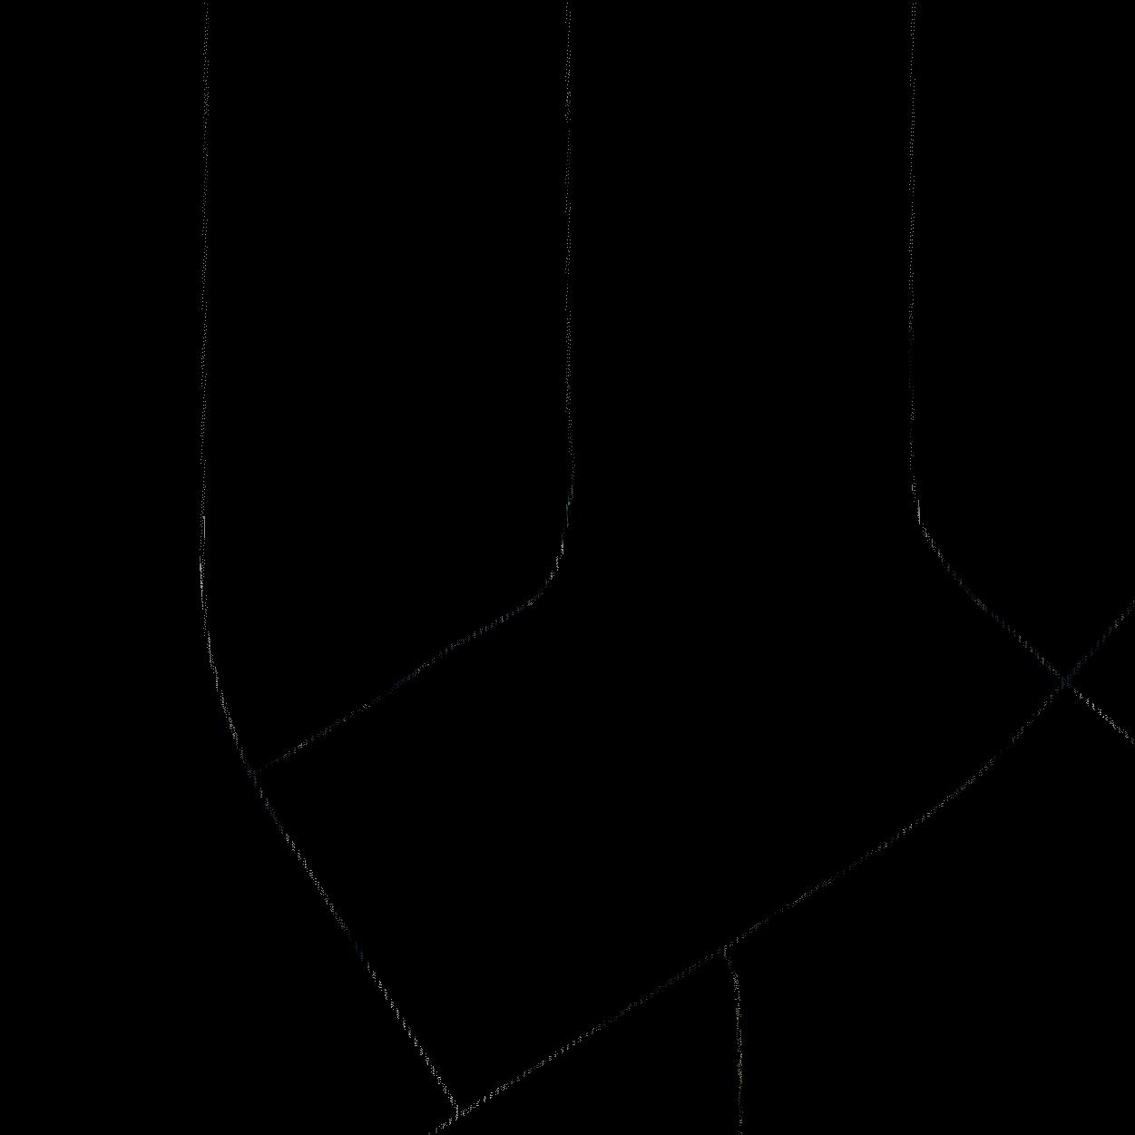
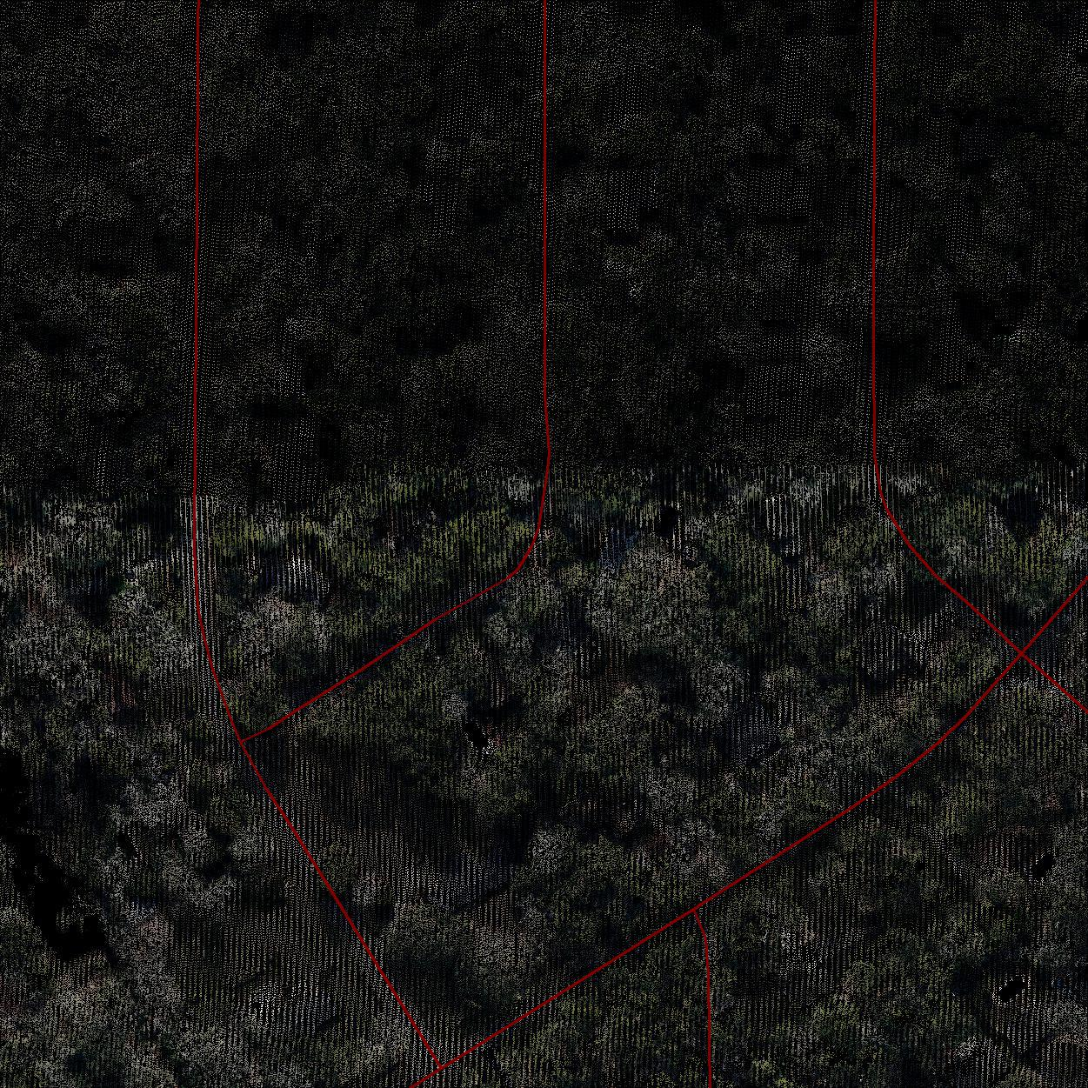
Prediction of road network
LIDAR data points corresponding to a road extracted from a shapefile
Road drawn on LIDAR image

Slide 9
Challenges and setbacks
  First of all we are using only default gamma and coefficient values of the SVM model.
  There are shadows on the road which dilute the RGB values.
  We may need to include more features because the current features may not be sufficient.
  Also the minimum distance between the polylines and the nearest data points drawn are dependent on the width of the road, which varies. We need to come up with an average width which would make the training dataset more compact.
  We have not been able to test the system properly because mostly it takes a very long time to train and predict. Our machines are not powerful enough to handle such huge amount of workload and crash at times, thus hindering the test procedure.

Slide 10
Outcome
  As planned and stated initially in our goals and plans we created a program that takes a LAS file of a particular region as an input and locate the road network present in that region.
  Also we present the output as an image file which shows the road network present in that region.

